Slide 1
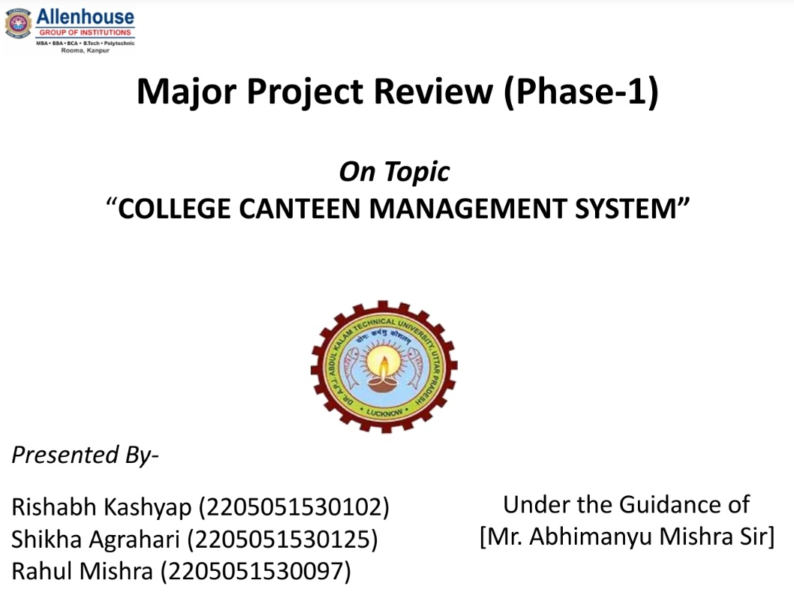

Slide 2

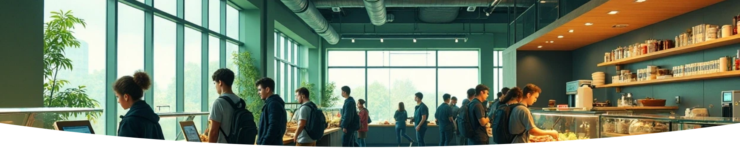
Introduction
Allenhouse Eatery: A Smart College Canteen Management System
Allenhouse Eatery is designed to address the challenges faced by students and staff in college canteens. This innovative system aims to enhance operational efficiency, improve convenience, and streamline the food ordering process. By leveraging technology, Allenhouse Eatery seeks to transform the dining experience within educational institutions, ensuring that both students and staff can enjoy seamless access to food services.

Slide 3

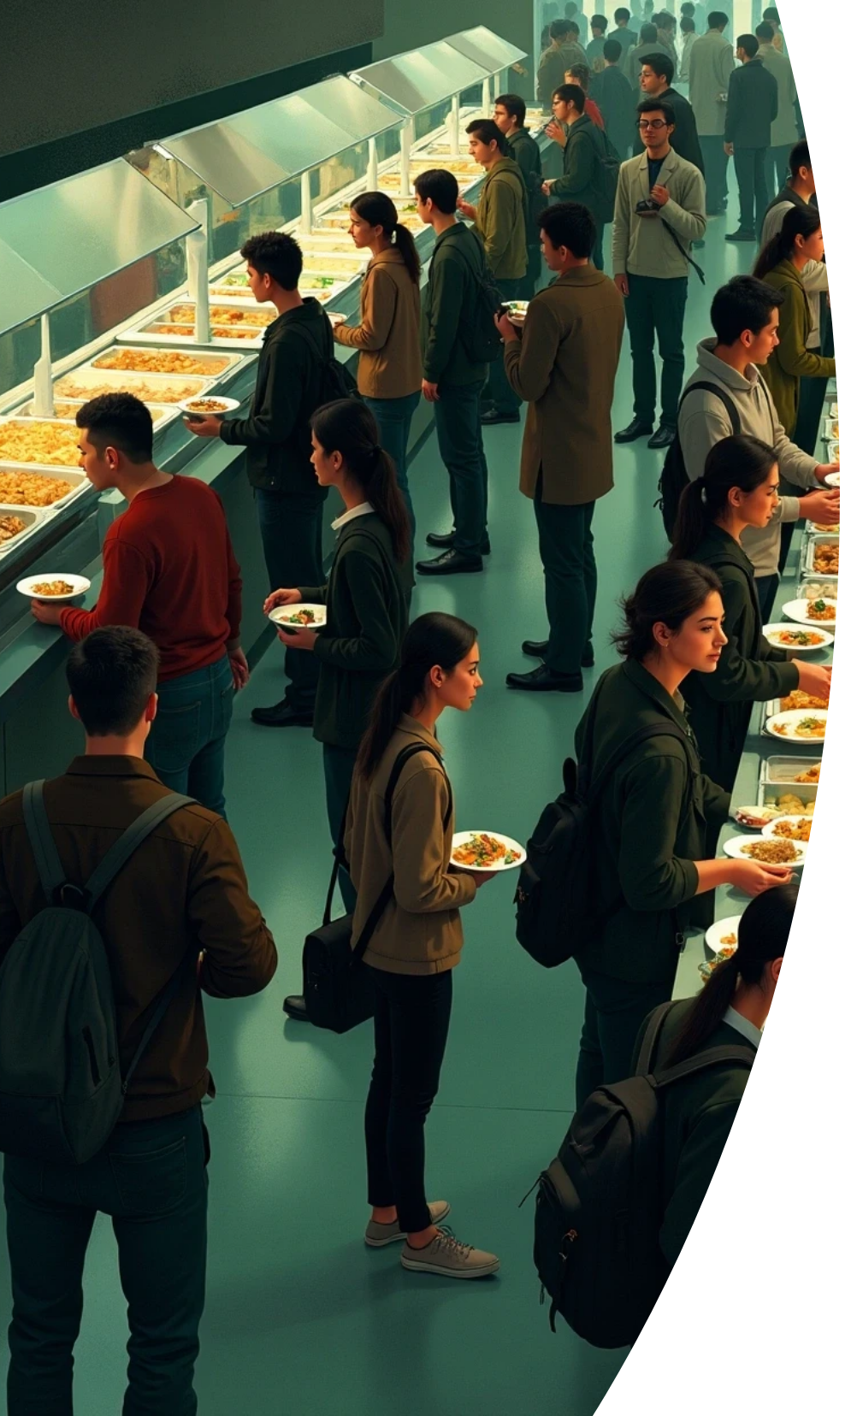

Problem Statement
Long Queues
Manual Billing
Students face long lines during peak hours, wasting valuable break time.
Current system involves manual billing, prone to delays and errors.
Menu Updates
Order Tracking
The canteen menu is not consistently updated, causing confusion.
No effective system for pre-booking or tracking orders.

Slide 4






Staff Issues
Bulk Order Handling
Billing Errors
Canteen staff struggle to manage bulk orders during rush hours, affecting service quality and efficiency.
Manual billing increases the chances of errors in recording orders and payments, which can lead to financial discrepancies.
1
2
Sales Data
4
3
Inventory Tracking
The absence of data on sales trends makes it difficult for staff to determine popular items and make informed purchasing decisions.
A lack of proper inventory management creates challenges in ensuring that popular items are always available.

Slide 5

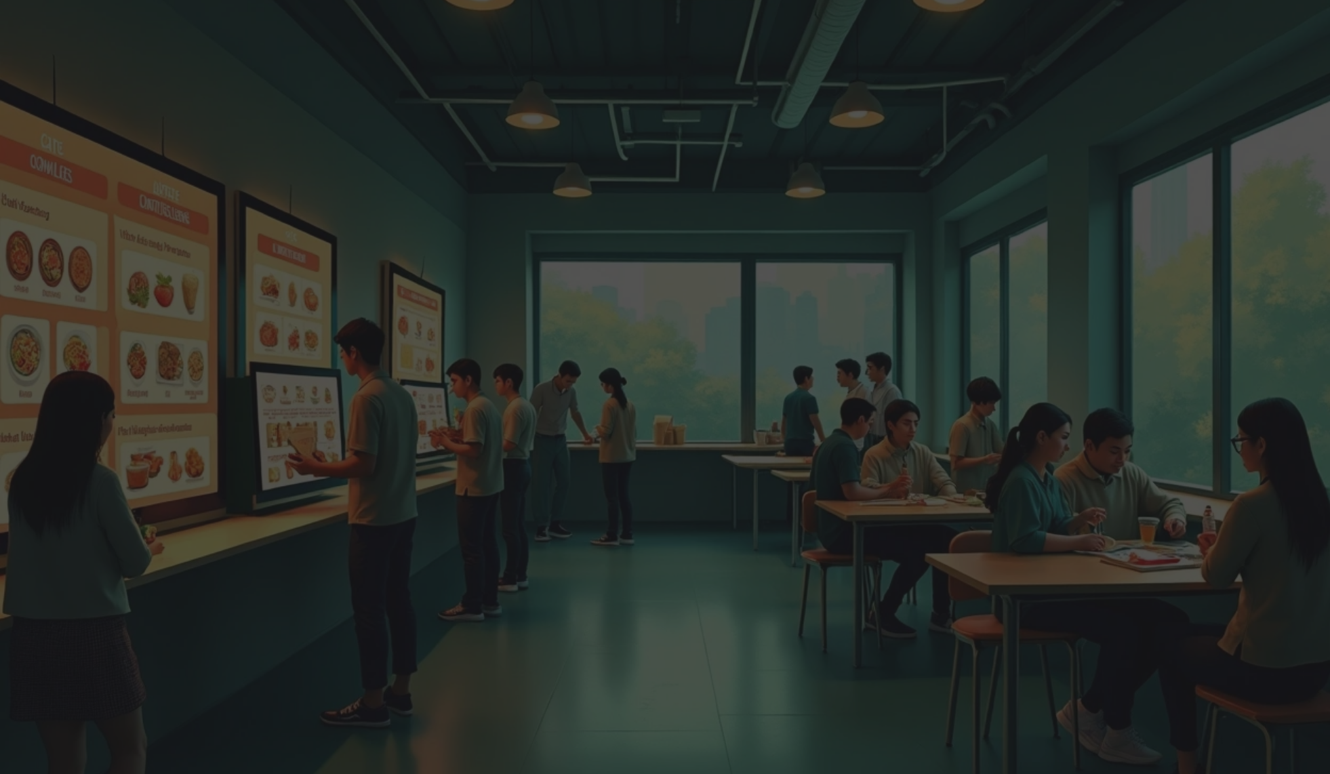


Objectives
User-friendly System
Online Ordering
To develop a user-friendly canteen management system that makes the ordering process more efficient and pleasant for students.
To enable online food ordering and facilitate digital payments, offering students convenience and reducing physical cash handling.
Reduced Waiting Times
Order Management
To decrease waiting time and streamline services, allowing students to quickly order and receive their food.
Enhance order tracking and management capabilities for staff to track orders and manage stock levels effectively.
Enhance Satisfaction
Enhance overall student satisfaction and operational efficiency, fostering a better canteen atmosphere.

Slide 6




Literature Survey / Background Research
1
Student Surveys
2
Management System Analysis
Gathered feedback on current canteen issues.
Identified strengths and weaknesses of existing systems.
3
Staff Insights Collection
4
Digital Solution Review
Collected insights about daily operational challenges.
Reviewed digital tools used by restaurants for inspiration.

Slide 7



Methodology / Approach
Requirement Analysis
Implementation
Deployment
Developing a web and app platform tailored to canteen operations.
Launching the system in Allenhouse College canteen for real-world use.
Understanding the needs and pain points of both students and staff.
1
2
3
4
5
6
System Design
Testing
Feedback & Improvement
Focusing on creating an intuitive UI/UX to enhance user experience.
Ensuring the system works seamlessly for ordering, billing, and stock management.
Continuously updating the system based on user feedback for ongoing enhancements.

Slide 8




Tools and Technologies Used
1
2
Frontend Development
Backend Development
Utilizing HTML, CSS, JavaScript and integration of React for dynamic interfaces.
Node.js will be used to create a robust backend capable of managing user data and transactions.
3
4
Database Management
Payment Integration
MongoDB will serve as the database solutions for data storage and retrieval.
Integrate secure payment gateways such as UPI, or Paytm for efficient transaction processing.
5
6
Hosting Solutions
Additional Tools
Deploy the application on reliable platforms like Vercel, Render or a local server for accessibility.
Employing GitHub for version control, figma for UI design .

Slide 9
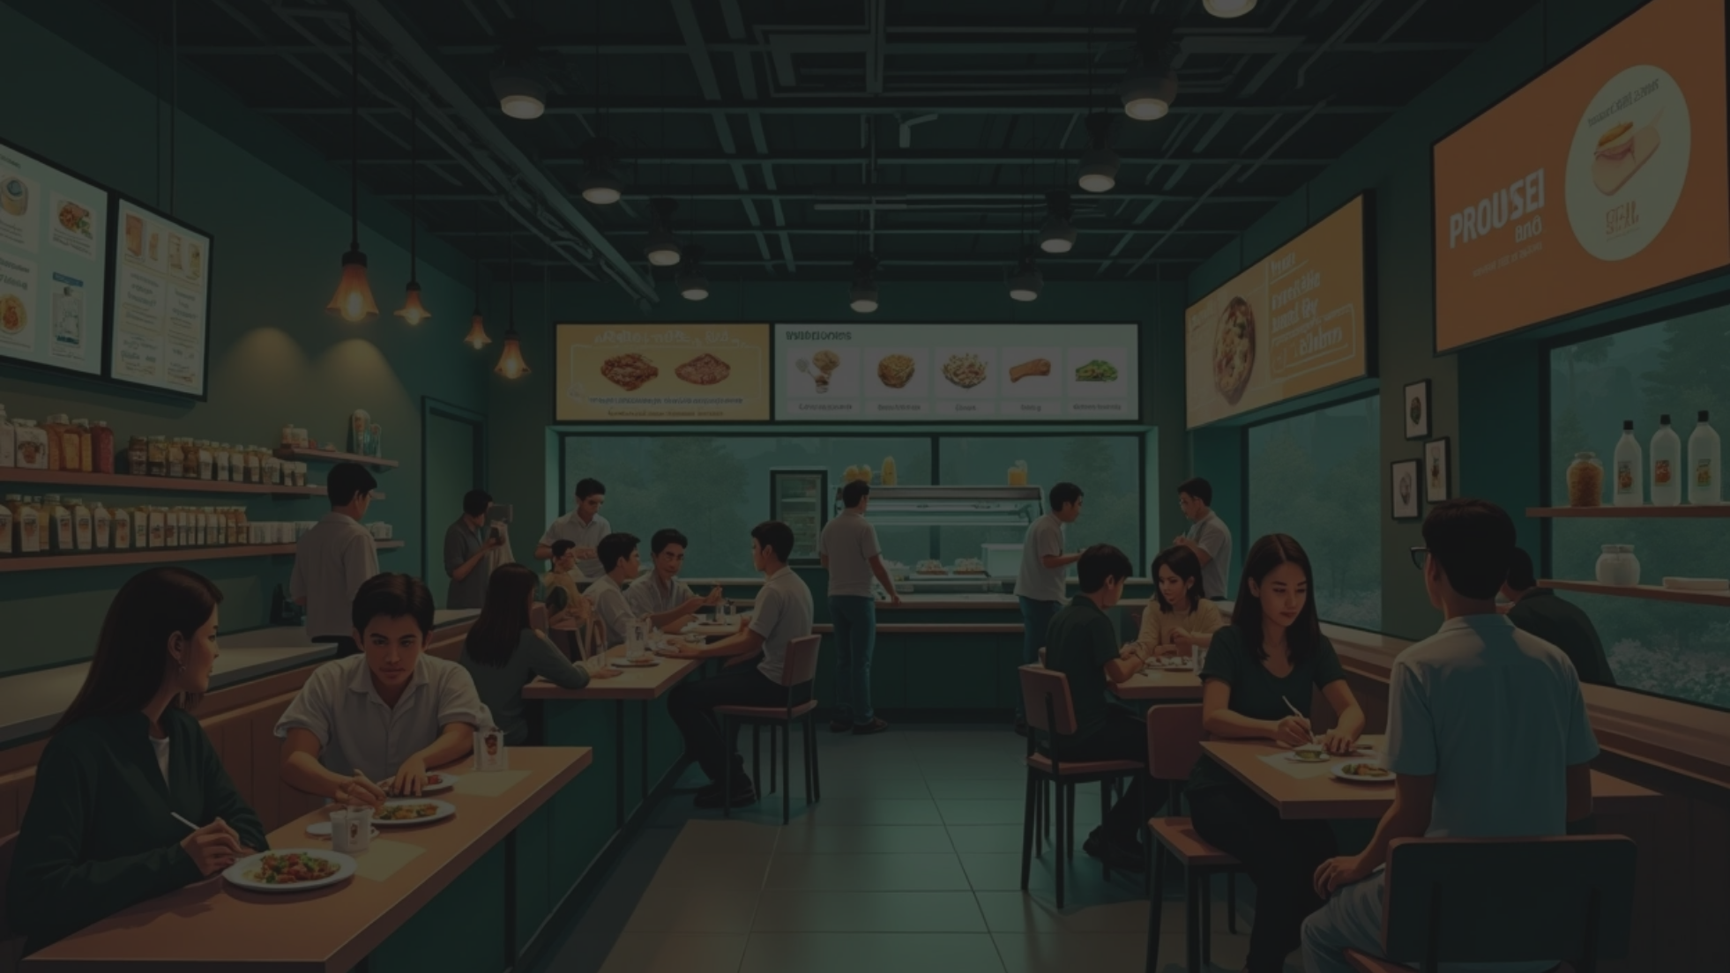


Expected Outcomes
Reduced Waiting Time
Transparent Billing
Enhanced Stock Control
Significant reductions in waiting time will lead to more efficient service.
Transparent billing processes will encourage more students, faculty members to use the system.
Enhanced stock and inventory control will help reduce wastage.
Improved Hygiene
Scalable Model
Hygiene and wastemanagement initiatives will foster a cleaner canteen environment.
A scalable model will serve as a blueprint for future implementations.

Slide 10
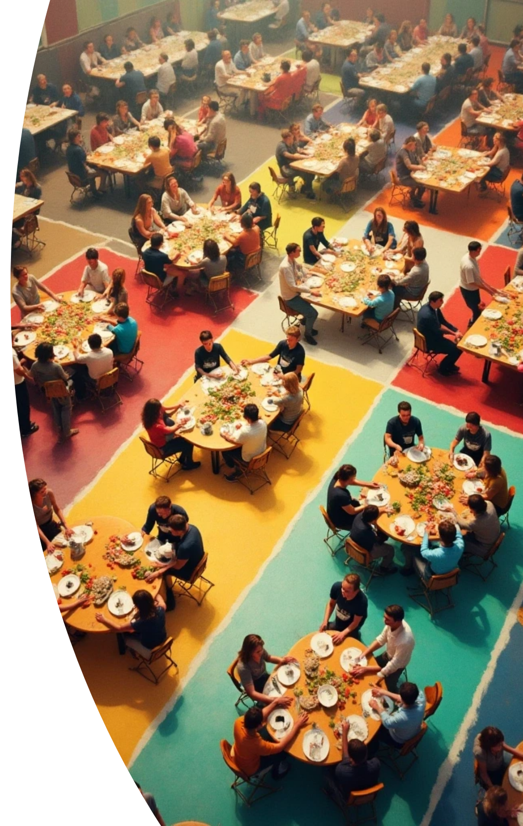
ThankYou!

